Slide 1


[CVPR 2022] COTS: Collaborative Two-Stream Vision-Language Pre-Training Model for Cross-Modal Retrieval
2022. 08. 30 Eung yeop Kim
Dept of AI

Slide 2
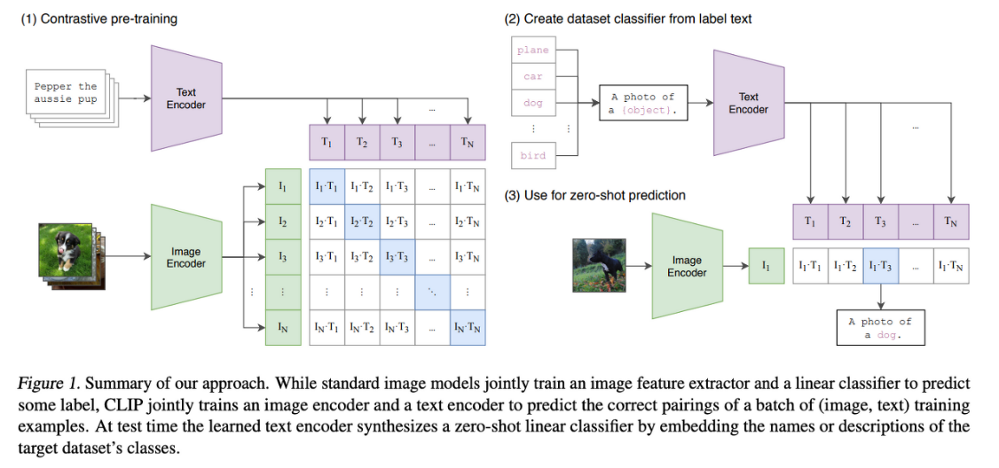
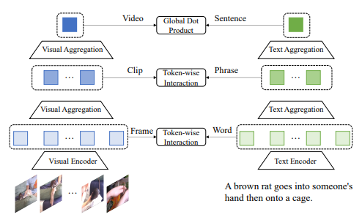
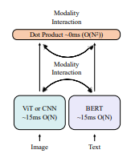
1. Abstract & Introduction
The main focus in these frameworks
1) Modality interaction in more deep way, for capturing the fine-grained clues.
2) Denoising entailed in the modality pairs in the dataset crawled from Internet.
https://openai.com/blog/clip/
HunYuan_tvr for Text-Video Retrieval
COTS

Slide 3
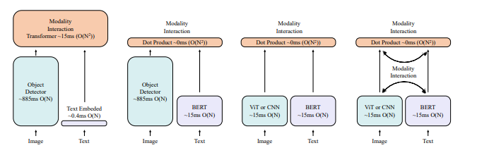
1. Abstract & Introduction
The main focus in these frameworks
1) Single stream models with Object detectors – Text embedding / BERT
2) Two stream models with Vision Transformers - BERT
3) Two stream models with multi – level modality interactions and adaptive Momentum filter.

Slide 4
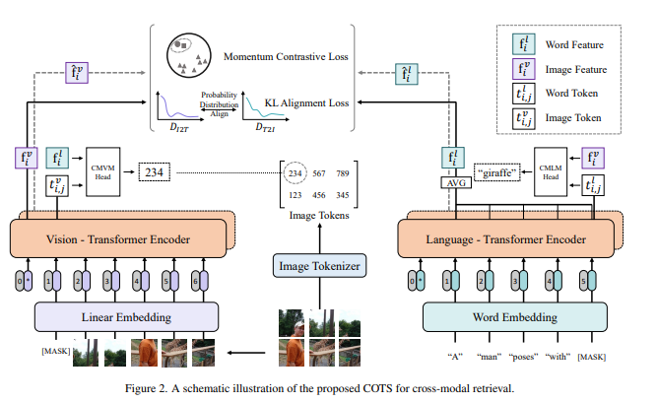
2. Methodology
Multi – level modality interactions
1) In the human perspective, we perceive a video-text pair by simultaneously, and intuitively.
2) The importance of scrutinizing the Intrinsic semantic difference between text and videos.
Task level interaction
Token level interaction
Instance level interaction

Slide 5
2. Methodology – Training Objectives
2.1 Token-Level Interaction
1) Masked vision-language modeling for predicting labels of masked image tokens.
- MVLM : cross-modal masked vision / cross-modal masked language Modeling
2) Why? : For Fine-grained interaction!
- Many previous trials failed to treat unknown targets.
- Raw pixels -> image tokens and vice versa.
- Each image tokens from dVAE are more helpful for token level interactions.

Slide 6





2. Methodology – Training Objectives
2.1 Token-Level Interaction
For every raw images,
Then, we can get the CMVM loss formulated as following,
Likewise, we are able to earn the CMLM loss

Slide 7


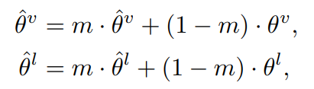
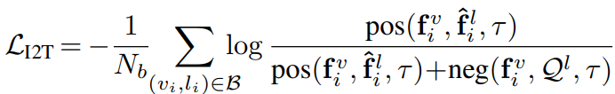
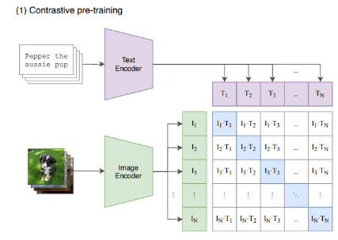
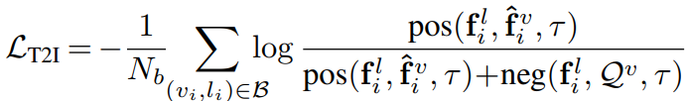
2. Methodology – Training Objectives
2.2 Instance-Level Interaction
These denote the parameters of momentum encoders, text, and video respectively.
Why Momentum Contrastive Learning?
1. It is not expensive to compute.
2. Dynamically responsive to query encoders.

Slide 8

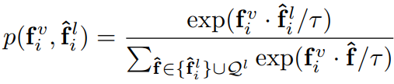
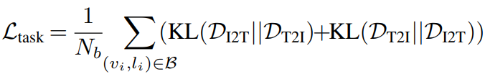
2. Methodology – Training Objectives
2.3 Task-Level Interaction
The two probability distributions are can be denoted as following:
Given the two representations in mini-batch, Each probability between them is formulated as
The Training objective of Task-level cross modal interaction within minimizing KL-Divergence

Slide 9







2. Methodology – Training Objectives
2.4 Adaptive Momentum Filter
1) To getting threshold on the web-crawled datasets.

Slide 10
3. Experiments
3.1 Implementation Details
1) modules
- Instance level encoders : BERT-base / ViT-B/16
- Token level modeling : 40% image patches, and 15% for text tokens are masked respectively.
2) Hyper parameter setting
- momentum = 0.99 / temp = 0.05 / Queue size = 12,800, 6,400, 1,200
- Learning rate =5e-5 for the first 5 epochs.
3) Evaluation metrics
- R@k (k = 1, 5, 10) top – k retrieval metrics.
- Median Rank (MR)

Slide 11
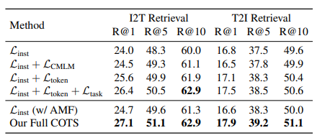



3. Experiments
3.2 Ablation study results
The ablation study indicates that full COTS are powerful for retrieval task.
Q1. which one is the more dominantly contribution between and ?
Q2. Is that meaningful to evaluate the ablation results between applying or not?

Slide 12
4. Conclusion & Future Work
Three – level cross modal interactions, for Fine-grained modality entanglement
1) Token Level Interaction – CVLM : masked token prediction
2) Instance Level Interaction - Momentum Contrastive Learning
3) Task Level Interaction - Minimizing the KL divergence Loss between Prob. Distribution of T2I, I2T.
Refining the mis-matched, noising pairs, within Adaptive Momentum Filter
1) Applying the Threshold for filtering out the mis-matching pairs.

